Slide 1
Catecholaminergic Polymorphic Ventricular Tachycardia & RYR2
Mercede Davis

Slide 2
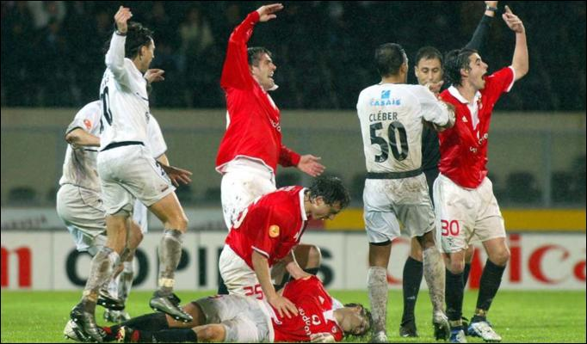
Sudden Cardiac Arrest in Athletes
https://www.youtube.com/watch?v=a-85uZVfa6g

Slide 3
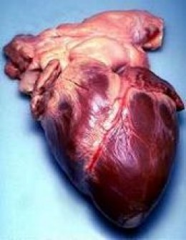
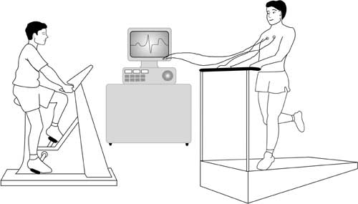
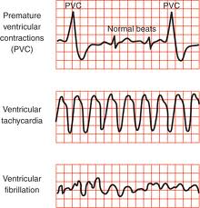
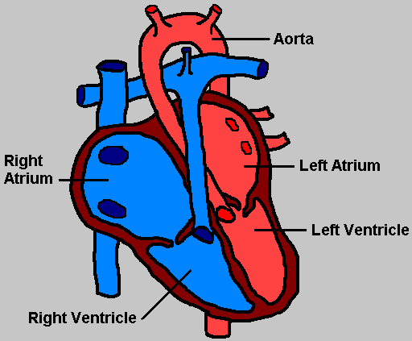
What are the symptoms of CPVT?
Notes:
Normal heart morphology
Pre-mature ventricular contractions
Dizziness or fainting during exercise or stress
Ventricular fibrillation/cardiac arrest
Brain damage due to lack of oxygen
Add normal human heart.

Slide 4
What gene is involved in CPVT?
RYR2
Encodes Ryanodine Receptor 2 protein
4967 amino acids
Notes:
Show domains of just human gene on this slide.

Slide 5
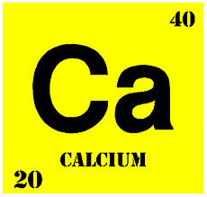
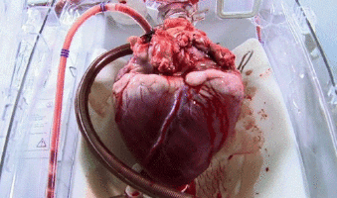
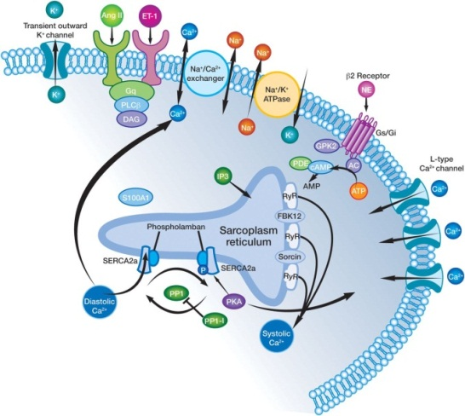
Gene Ontology of RYR2
Cellular Molecular Biological
Component Function Process
Notes:
Add photos for each GO term

Slide 6
How does RYR2 function in heart muscle?
Cardiac muscle cell
RYR2

Slide 7
How does mutation affect RYR2 function?
RR_TM-4-6 domain
calcium homeostasis
Responsible for pumping mechanism
Ion_trans domain
ion specificity
RYDR_ITPR domain
localized to membrane
ion-transport function
Notes:
Many regions functions are still unknown.--→ can’t completely classify every SNP

Slide 8
How well is RYR2 conserved?
Human RYR2
4967 aa
Mouse RYR2
4966 aa
97%
Turtle RYR2
4876 aa
94%
Bullfrog RYR beta isoform
69%
4868 aa
Zebra Fish RYR2b
4882 aa
64%
Lobster RYR
1513 aa
57%
C. elegans Unc-68
5200 aa
47%
Notes:
Vertical line represents CPVT causing mutation
Many regions functions are still unknown.--→ can’t completely classify every SNP

Slide 9
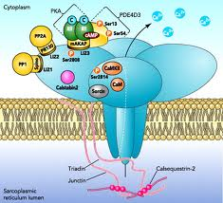
How is RYR2 functioning differently in the ventricles?

Slide 10
Aim 1
Aim 1: To determine how well conserved RYR2 is in species of different heart morphologies
Notes:
Thought to cause leaki-ness in receptor…

Slide 11
Which models will be chosen?
Zebra Fish
Turtle
Bullfrog
Mouse
Notes:
Thought to cause leaki-ness in receptor…
How well conserved is RYR2 conserved in species of different morphology…

Slide 12
How well conserved is RYR2 in species of different heart morphologies?
Mouse RYR2 (4966 aa)
97%
Turtle RYR2 (4876 aa)
94%
Bullfrog RYR beta isoform(4868 aa)
69%
Zebra Fish RYR2b (4882 aa)
64%
Notes:
Thought to cause leaki-ness in receptor…
How well conserved is RYR2 conserved in species of different morphology…

Slide 13
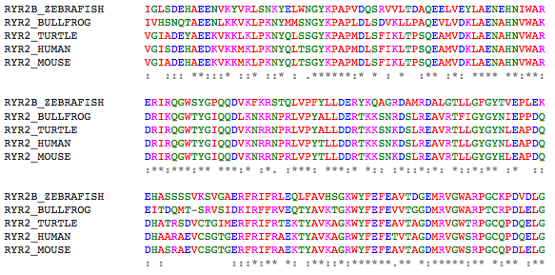
Clustal Omega sequence alignment of ion-trans domain
RYR2B_ZEBRAFISH HELWLIDKIEQGWTYGPVKDEGKKVHLCLVEFSKLPDQERIHTLQSSEDILRTLLAFGVH
RYR2_BULLFROG HELWGMNKIELGWIYGKVRDDNKRQHPCLVEFSKLPETEKNYNLQMSTETLKTLLALGCL
RYR2_TURTLE HELWVMNKIELGWQYGPVRDDNKRQHPCLIEFSKLPEQERNYNLQMSLETLKTLLALGCH
RYR2_HUMAN HELWVMNKIELGWQYGPVRDDNKRQHPCLVEFSKLPEQERNYNLQMSLETLKTLLALGCH
RYR2_MOUSE HELWVMNKIELGWQYGPVRDDNKRQHPCLVEFCKLPEQERNYNLQMSLETLKTLLALGCH
**** ::*** ** ** *:*: *: * **:**.***: *: :.** * : *:****:*
RYR2B_ZEBRAFISH IGLSDEHAEENVKYVRLSNKYELWNGYKPAPVDQSRVVLTDAQEELVEYLAENEHNIWAR
RYR2_BULLFROG IVHSNQTAEENLKKVKLPKNYMMSNGYKPAPLDLSDVKLLPAQEVLVDKLAENAHNVWAK
RYR2_TURTLE VGIADEYAEEKVKKLKLPKNYQLSSGYKPAPMDLSFIKLTPSQEAMVDKLAENAHNVWAR
RYR2_HUMAN VGISDEHAEDKVKKMKLPKNYQLTSGYKPAPMDLSFIKLTPSQEAMVDKLAENAHNVWAR
RYR2_MOUSE VGIADEHAEEKVKKMKLPKNYQLTSGYKPAPMDLSFIKLTPSQEAMVDKLAENAHNVWAR
: ::: **:::* ::* ::* : .******:* * : * :** :*: **** **:**:
RYR2B_ZEBRAFISH ERIRQGWSYGPQQDVKFKRSTQLVPFYLLDERYKQAGRDAMRDALGTLLGFGYTVEPLEK
RYR2_BULLFROG DRIKQGWTYGIQQDLKNKRNPRLVPYALLDERTKKSNRDSLREAVRTFIGYGYNIEPPDQ
RYR2_TURTLE DRIRQGWTYGIQQDVKNRRNPRLVPYALLDDRTKKSNKDSLREAVRTLLGYGYNLEAPDQ
RYR2_HUMAN DRIRQGWTYGIQQDVKNRRNPRLVPYTLLDDRTKKSNKDSLREAVRTLLGYGYNLEAPDQ
RYR2_MOUSE DRIRQGWTYGIQQDVKNRRNPRLVPYTLLDDRTKKSNKDSLREAVRTLLGYGYHLEAPDQ
:**:***:** ***:* :*. :***: ***:* *:: :*::*:*: *::*:** :* ::
RYR2B_ZEBRAFISH EHASSSSVKSVGAERFRIFRLEQLFAVHSGKWYFEFEAVTDGEMRVGWARPGCKPDVDLG
RYR2_BULLFROG EITDQMT-SRVSIDKIRFFRVEQTYAVKTGKWYFEFEVVTGGDMRVGWARPTCRPDLELG
RYR2_TURTLE DHATRSDVCTGIMERFRIFRTEKTYAVKAGKWYFEFEAVTAGDMRVGWTRPGCQPDQELG
RYR2_HUMAN DHAARAEVCSGTGERFRIFRAEKTYAVKAGRWYFEFETVTAGDMRVGWSRPGCQPDQELG
RYR2_MOUSE DHASRAEVCSGTGERFRIFRAEKTYAVKAGRWYFEFEAVTAGDMRVGWSRPGCQPDLELG
: : :::*:** *: :**::*:******.** *:*****:** *:** :**
RYR2B_ZEBRAFISH SDDQAFVFDGSKGQWWHGGAERLGGCWKRGDVIGCLLDLTTDTMMITLNGEQLLNSHGSE
RYR2_BULLFROG ADDRAFVFEGSRGQCWNMGSSFFGRNWQPGDVVGSMINLDDKSMIFTLNGELLITNQGSE
RYR2_TURTLE SDEQAFVFDGFKAQRWHQGNEHFGRSWLAGDVVGCMVDMNEHTMMFTLNGEILLDDSGSE
RYR2_HUMAN SDERAFAFDGFKAQRWHQGNEHYGRSWQAGDVVGCMVDMNEHTMMFTLNGEILLDDSGSE
RYR2_MOUSE SDDRAFAFDGFKAQRWHQGNEHYGRSWQAGDVVGCMVDMNEHTMMFTLNGEILLDDSGSE
f
Notes:
Thought to cause leaki-ness in receptor…

Slide 14
Aim 2
Aim 2: Further categorize domains with unknown function and their role for RYR2 localization in atria and ventricles

Slide 15
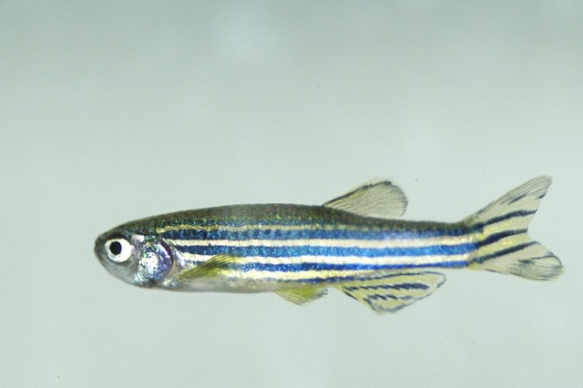
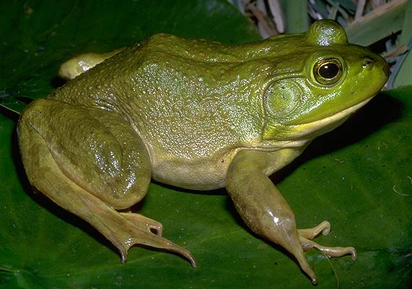
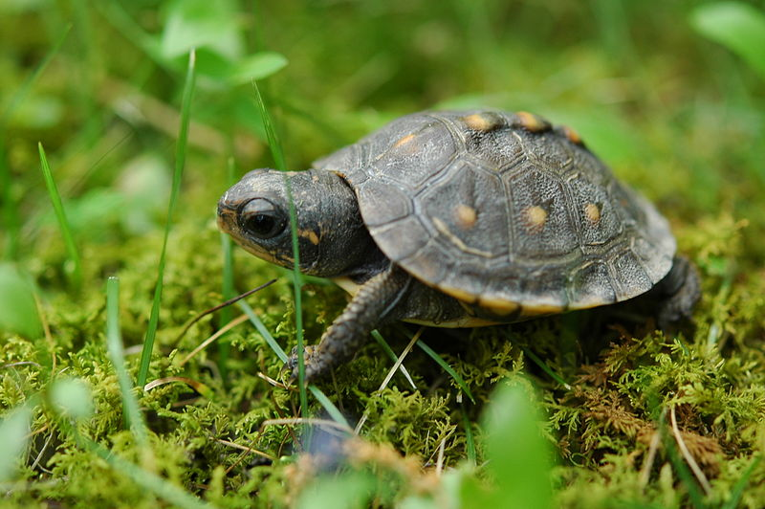
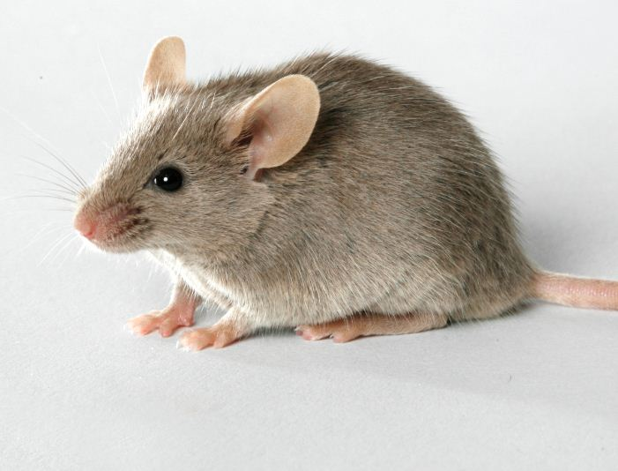
How will aim 2 be conducted?
Notes:
Thought to cause leaki-ness in receptor…

Slide 16
Expected Results
Atria Ventricles
Notes:
Thought to cause leaki-ness in receptor…

Slide 17
Aim 3
Aim 3: To determine protein binding sites within domains of unknown functions to help determine how RYR2 is functioning differently between the atria and ventricles
Notes:
Thought to cause leaki-ness in receptor…

Slide 18
Aim 3 approach: TAP-TAG
TAP
TAP
TAP
TAP
Notes:
Thought to cause leaki-ness in receptor…

Slide 19
Aim 3: Expected Results
P
TAP
RYR2
MASS SPEC
TAP
RYR2 with deletion
Notes:
Thought to cause leaki-ness in receptor…

Slide 20
Future Directions
Determine which specific amino acids are responsible for localization and protein binding to further classify individual SNPs associated with CPVT
Notes:
Thought to cause leaki-ness in receptor…

Slide 21
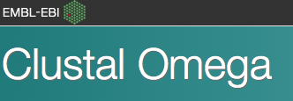
References
[1] Gene Reviews. (2013). Electronic references. Retrieved January 31, 2014, from
http://www.ncbi.nlm.nih.gov/books/NBK1289/
[2]SADS Foundation. (2008). Electronic references. Retrieved February 1, 2014 from
http://www.sads.org/library/cpvt#.UuQigDl6i1s
[3]Paivi J. Laitinen, Kevin M. Brown, Kirsi Piippo, Heikki Swan. (2001). Mutations in Cardiac Ryanodine Receptor (RyR2) Genein Familial Polymorphic Ventricular Tachycardia. Circulation. 103. 485-490. doi 10.1161/01.CIR.103.4.485 http:// circ.ahajournals.org/content/103/4/485.full.pdf+html
http://www.rudyard.org/real-human-heart
http://www.fcps.edu/islandcreekes/ecology/bullfrog.ht,m
http://kkcdn-static.kaskus.co.id/images/2013/01/03/5045198_20130103072618.jpg
//katedeering.com/archives/1243
http://giphy.com/search/beating-heart/
http://bioserv.fiu.edu/~biolab/labs/1011/Spring%202009/Task%20Sheets/Week%2010_Circulatory%20and%20Respiratory%20systems.htm
Images:
http://fin6.com/2013/12/mouse/
http://physiologyonline.physiology.org/content/22/5/342
http://commons.wikimedia.org/wiki/File:Baby_turtle.jpg
http://www.focusonnature.be/gallery/zebrafish
Notes:
Thought to cause leaki-ness in receptor…

Slide 22
Questions
?
?

